Slide 1
KNN
Jiaqi Zhang

Slide 2
Agenda
k-NN Introduction
Problem
Sequential solution
Parallel Solutions
Test Results
Comparison

Slide 3
K-NN Introduction
KNN is a classic algorithm first introduced in the field of statistics
KNN classifications
Wide Applications

Slide 4
Problem
slightly modified version of traditional k-NN
Two sets of vectors
Goal: for each vector in nx find topK (K=5) nearest vectors in ny
distance metrics: Euclidean distance
Labels are assigned by majority vote

Slide 5
Dataset
Two data sets A and B
Same dimension: 256
Different length: N(B) = 128N(A)
Last element of vector is label
V1
V2
Vn

Slide 6
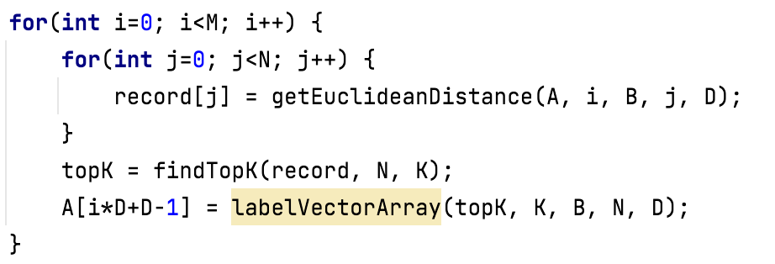
Sequential

Slide 7
Find Topk
Quick Select
3 | 5 | 1 | 2 | 7 | 4 | 8 | 0 | 9 | 6
3 | 5 | 1 | 2 | 4 | 0 | 6 | 7 | 8 | 9
1 | 0 | 2 | 3 | 5 | 4 | 6

Slide 8
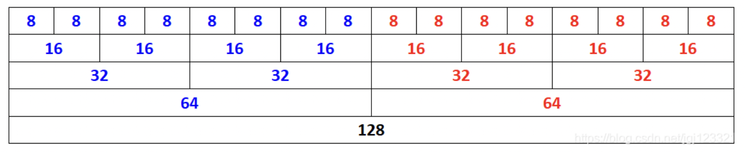
Other Improvement - SSE Instruction Set
Utilizing SSE instruction set to calculate the Euclidean distance
SSE has added 128-bit registers
All calculations in SSE are done for 4 floating-point numbers at one time

Slide 9
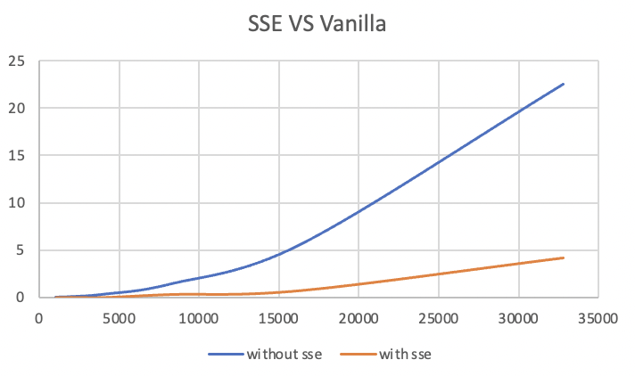
SSE - Results

Slide 10
pthreads
Pthread allows a program to control multiple different flows of work that overlap in time.
Main idea
Three Steps
Create threads
KNN calculation
Join Threads

Slide 11
Open MPI
Main idea
Five Steps:
Distribute rows
Calculate distances and record results
Gather records
Select topK

Slide 12
OpenMP
OpenMP brief introduction
Add pragma
Two steps
Get all distances between two matrics
Select topK distances from records

Slide 13
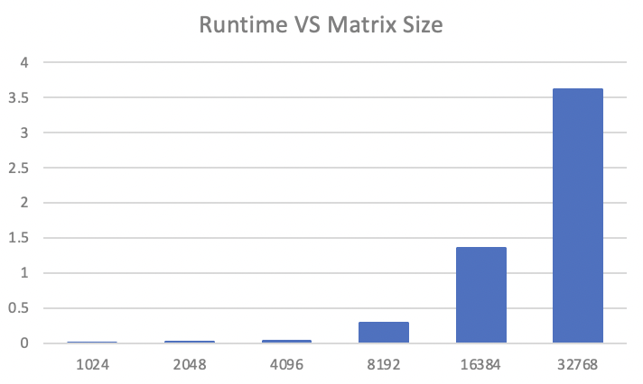
Test Results – Sequential
Figure 1. Runtime vs Matrix Size - Sequential

Slide 14
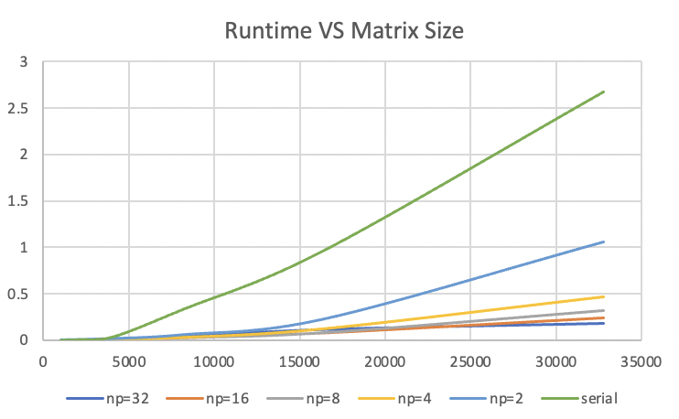
Test Results - Pthreads
Figure 3. pthread VS sequential

Slide 15
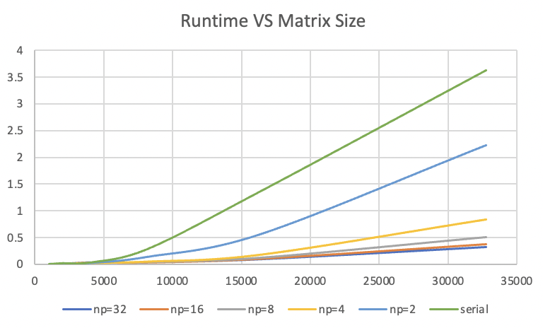
Test Results - MPI
Figure 2. MPI VS sequential

Slide 16
Test Results - OpenMP
Figure 4. OpenMP VS sequential

Slide 17
Comparison - Similarities
Powerful parallel programming tools
Intuitions are similar
The performances of three methods are highly related to the number of threads
Unlike CUDA and Vector Blox, Optimization Settings can greatly improve performances of three methods.

Slide 18
Comparison - Differences
pthreads and MPI are very low-level APIs, OpenMP is higher level
The strategies are different
Programming models are different
OpenMP is an alternative way of pthreads

Slide 19
Conclusion
K-NN is an important algorithm with many applications
Utilize quick select algorithm to pick topK vectors
Use SSE instruction set to calculate Euclidean Distance can improve the performance
MPI, OpenMP and pthreads can greatly improve performance

Slide 20
Thank you!

